Slide 1



Internship defense
Open-source development of a frequency correlation kernel for metamodels.
Nicolas GONEL
Sept, 09 2024
Supervisors: J. Morlier (ISAE-SUPAERO) and P. Saves (ONERA)

Slide 2
01
Motivation
Contents
02
03
04
04
Gaussian
Process
Frequency
Kernel
VALIDATION
Conclusions Perspectives

Slide 3
01
Motivation
Contents
02
03
04
04
Gaussian
Process
Frequency
Kernel
VALIDATION
Conclusions Perspectives

Slide 4
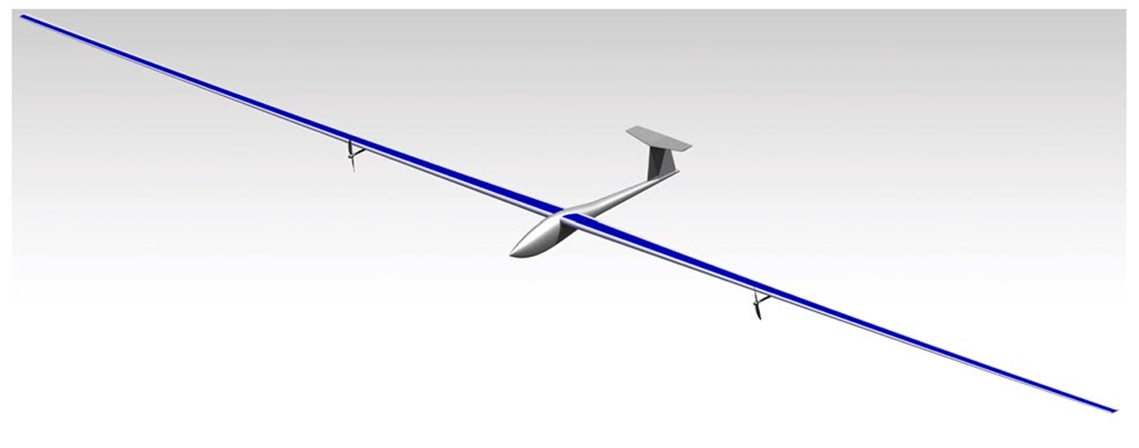
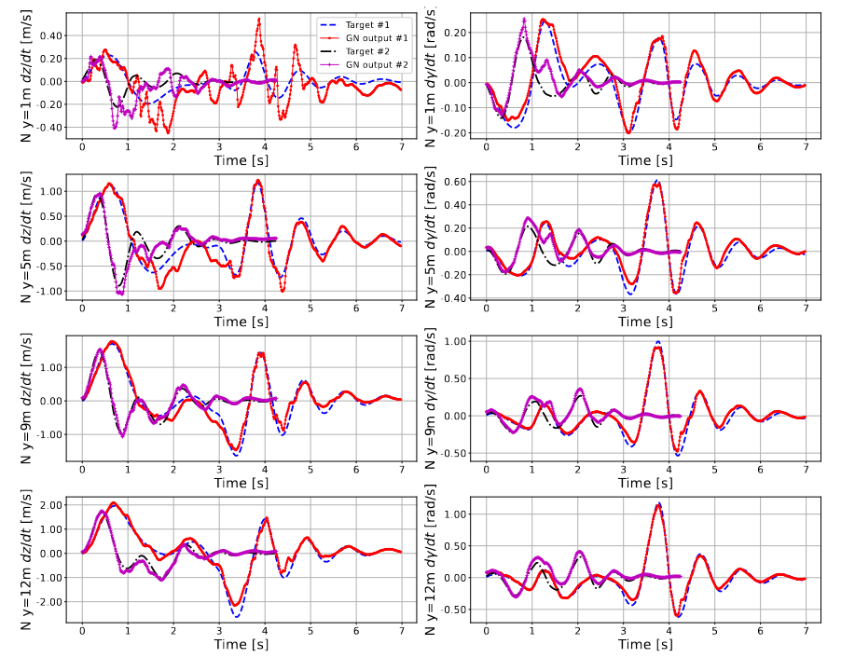
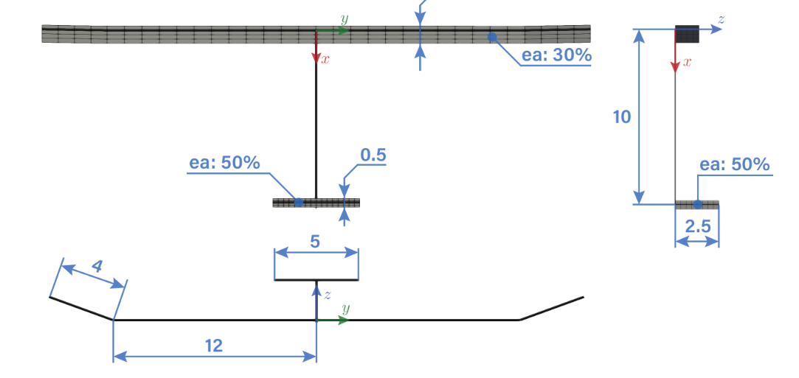
Aircraft modelization: HALE aircraft
Prediction of nodal displacement with neural network in case of gust
Expensive to evaluate (aeroelastic problem or neural network)
No derivative available
HALE Aircraft Geometry
E. Duriez, V.M. Guadaño Martín & J. Morlier, footprint minimization of solar-powered HALE using MDO and eco-material selection. Sci Rep 13, 11994 (2023).
M. Colombo, J. Morlier and M. Bauerheim. "Prediction of Gust Aeroelastic performance of HALE using Graph Neural Networks,". AIAA SCITECH 2023 Forum.

Slide 5
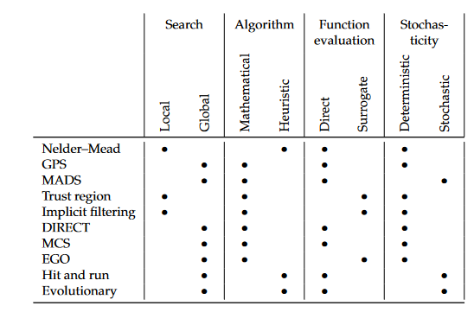
Expensive black-box optimization
Expensive-to-evaluate
Black-box (no derivative)
Surrogate-based
Global optimization
Constrained problems
Global aspect
Evolutionary algorithms
Bayesian Optimization
Gradient-based algorithms
Bayesian optimization (Efficient Global Optimization) can solve efficiently an expensive black-box problem.
Number of function evaluations
J. Martins, A. Ning, Engineering design optimization, 2021, Cambridge University Press.
D. Jones, M. Schonlau, W. Welch, Efficient global optimization of expensive black-box functions, 1998, Journal of Global optimization.

Slide 6
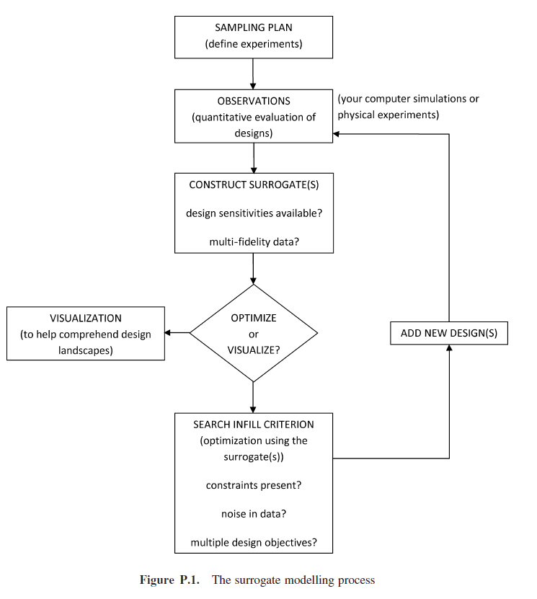
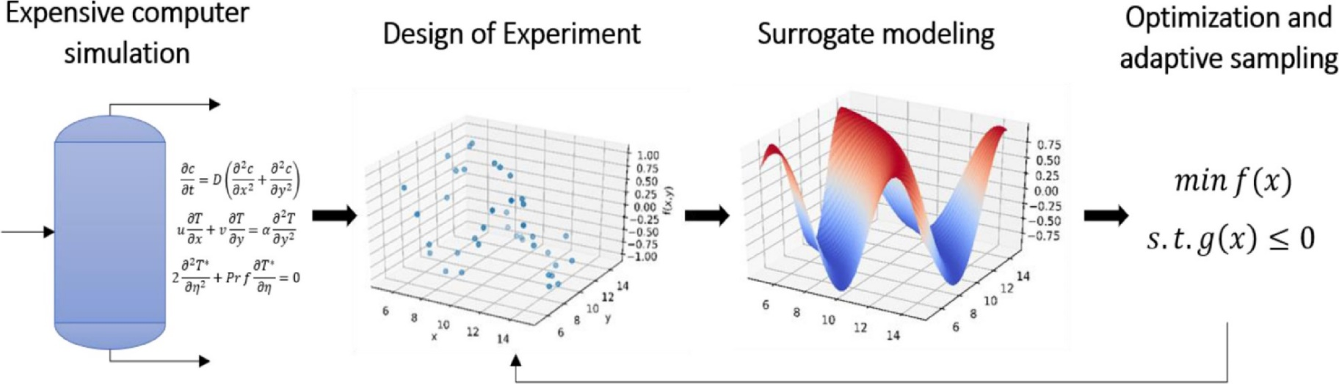


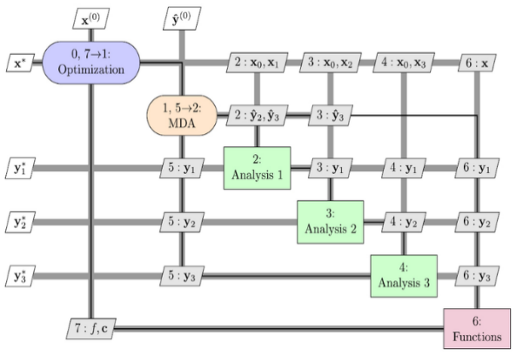
Surrogate modeling
A
Sampling
A
A
B
Models
B
D
Optimization
C
Bayesian optimization: Adaptive sampling
Analysis & Exploitation
S. Kim, F. Boukouvala, Surrogate-Based Optimization for Mixed-Integer Nonlinear Problems, 2020, Computers & Chemical Engineering.
S. Forrester, A. Sobester, A. Keane, Engineering Design via Surrogate Modelling: A Practical Guide, 2008, Wiley.

Slide 7
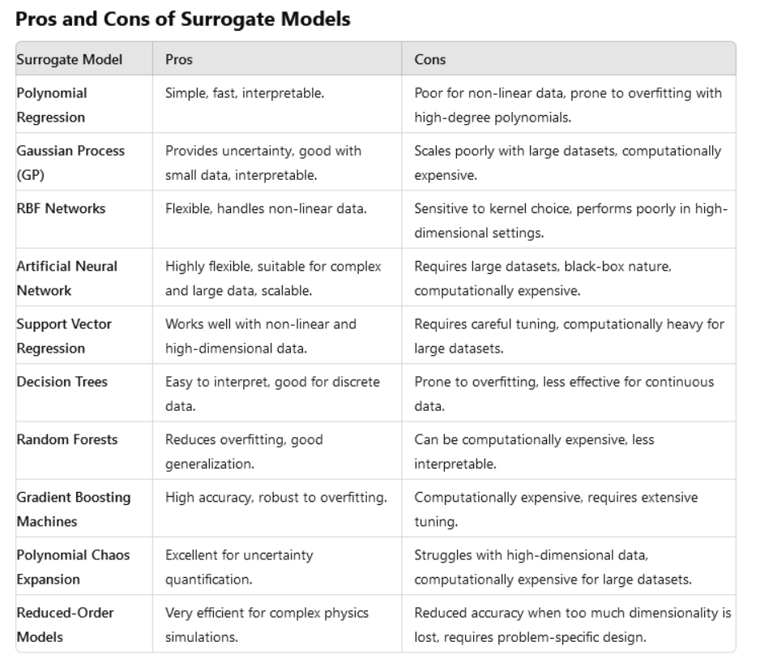
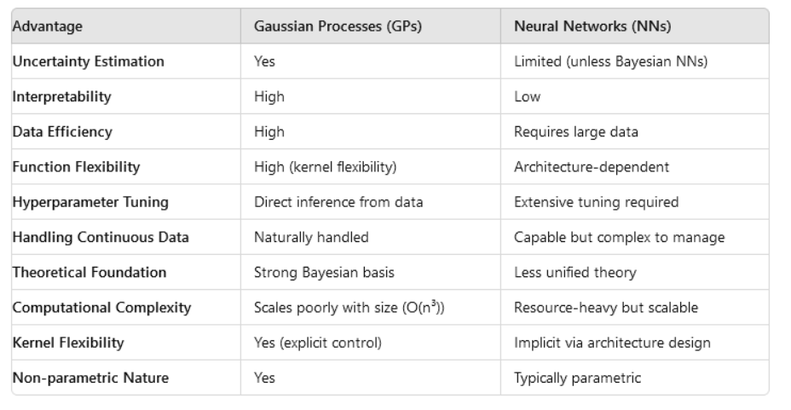
Surrogate modeling
In-depths comparison of GP vs NN
Comparison of various surrogate models

Slide 8
01
Motivation
Contents
02
03
04
04
Gaussian
Process
Frequency
Kernel
VALIDATION
Conclusions Perspectives

Slide 9
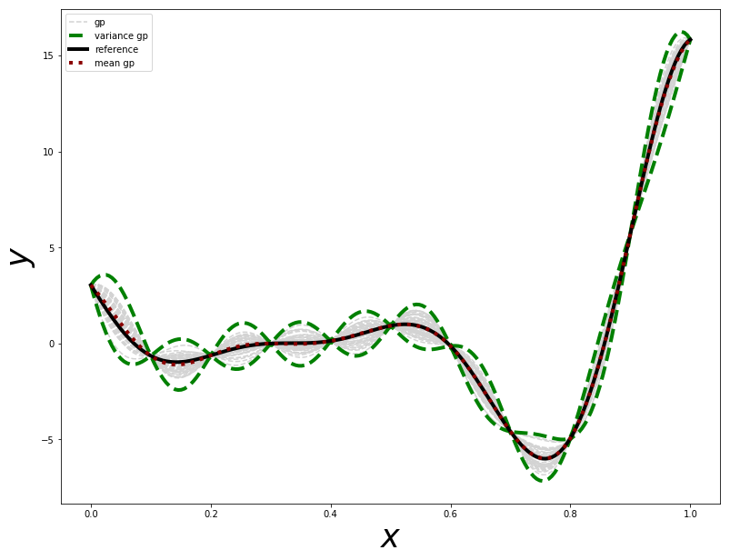
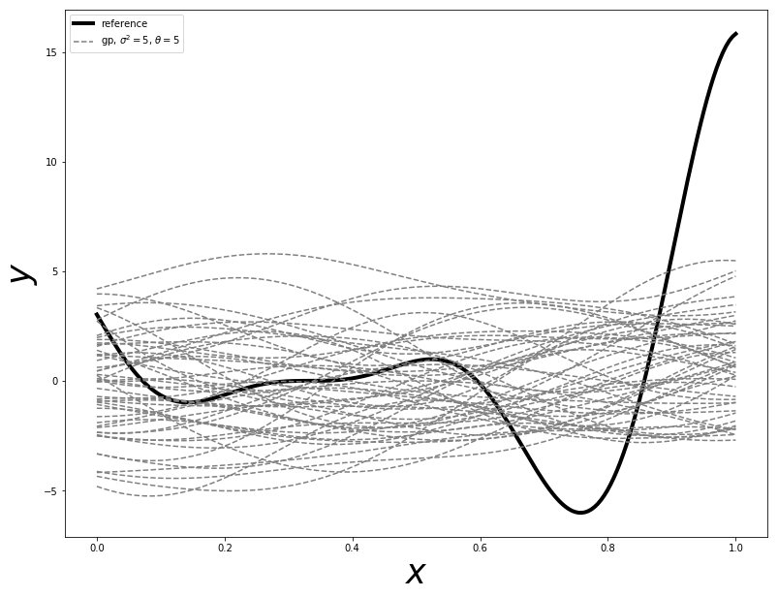
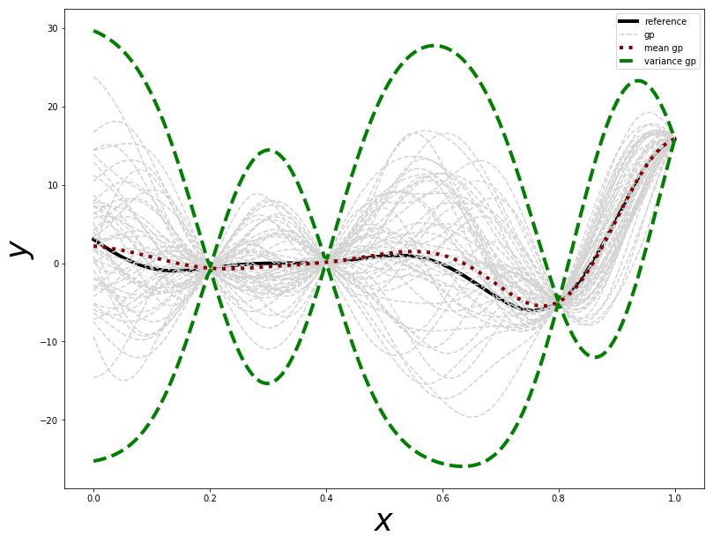
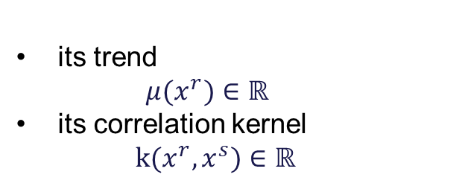
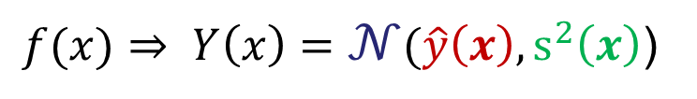
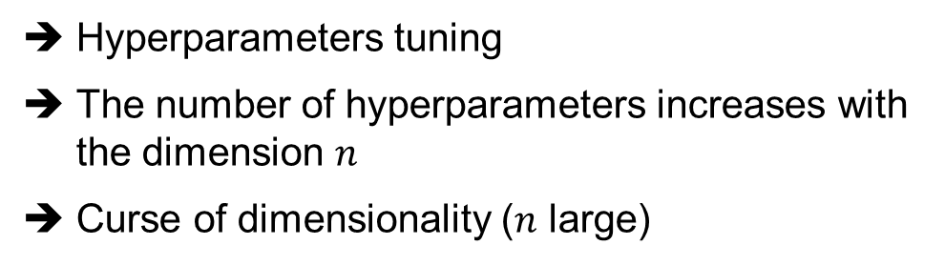
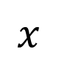
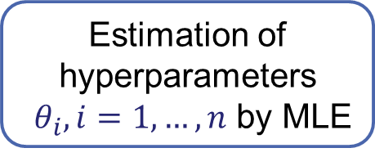

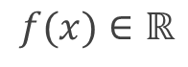
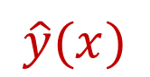
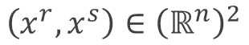
Gaussian process (or Kriging model)
no point
4 points
11 points
$$\left(x^{r},x^{s}\right)∈{\left(ℝ^{n}\right)}^{2}$$
$f(x)∈$ $ℝ$
A Gaussian process (GP) is characterized by:
its trend
$$μ(x^{r})∈ℝ$$
its correlation kernel
$k(x^{r},x^{s})∈ℝ$
$$\hat{y}\left(x\right)±3 \hat{s}(x)$$
$$\hat{y}(x)$$
99% confidence
interval
$$x$$
Estimation of
hyperparameters
$θ_{i},i=1, …, n$ by MLE
Hyperparameters tuning
The number of hyperparameters increases with the dimension $n$
Curse of dimensionality ($n$ large)
$f(x)⇒ Y\left(x\right)=𝒩(\hat{y}\left(x\right), s^{2}\left(x\right)$)
D. Krige, A statistical approach to some basic mine valuation problems on the Witwatersrand, 1951, Journal of the Southern African Institute of Mining and Metallurgy.

Slide 10
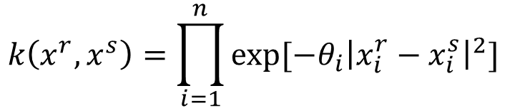
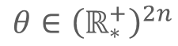
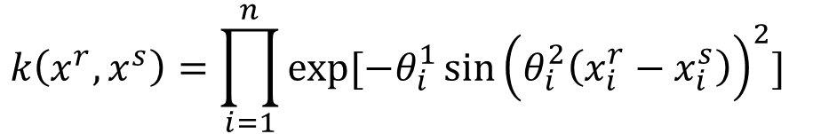
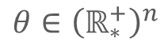
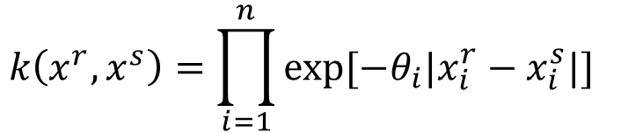
Kernels for Gaussian process
Exponential kernels
$$\left(x^{r},x^{s}\right)∈{\left(ℝ^{n}\right)}^{2}$$
$f(x)∈$ $ℝ$
$$θ∈{\left(ℝ_{∗}^{+}\right)}^{n}$$
$$k\left(x^{r},x^{s}\right)=\prod_{i=1}^{n}{exp⁡[−θ_{i}|x_{i}^{r}−x_{i}^{s}|]}$$
Absolute exponential
A Gaussian process (GP) is characterized by:
its trend
$$μ(x^{r})∈ℝ$$
its correlation kernel
$k(x^{r},x^{s})∈ℝ$
$$k\left(x^{r},x^{s}\right)=\prod_{i=1}^{n}{exp⁡[−θ_{i}{\left|x_{i}^{r}−x_{i}^{s}\right|}^{2}]}$$
Squared Exponential
Kernel of interest:
$$k\left(x^{r},x^{s}\right)=\prod_{i=1}^{n}{exp⁡[−θ_{i}^{1}{\sin\left(θ_{i}^{2}\left(x_{i}^{r}−x_{i}^{s}\right)\right)}^{2}]}$$
Periodic
$$θ∈{\left(ℝ_{∗}^{+}\right)}^{2n}$$
D. Krige, A statistical approach to some basic mine valuation problems on the Witwatersrand, 1951, Journal of the Southern African Institute of Mining and Metallurgy.

Slide 11






Open-source toolbox for surrogate models
SMT 2.0 features:
Models to handle a large number of design variables (KPLS – KPLSK – MGP): automatic number of components
Mixture of experts to handle heterogeneous functions (MOE)
Different covariance kernels added
Multi-fidelity models (MFK – MFKPLS – MFKPLSK)
Noisy kriging to handle uncertainties on data
Kriging models for mixed variables (continuous, discrete, categorical) & associated kernels, sampling and optimization
Kriging models for hierarchical variables (meta, neutral, decreed) & associated kernels, sampling and optimization
Benchmarking problems
➔ Included some Jupyter notebooks & documentation
github.com/SMTorg/smt
P. Saves, R. Lafage, N. Bartoli, Y. Diouane, J. Bussemaker, T. Lefebvre, J. Hwang, J. Morlier, J. Martins, SMT 2.0: A Surrogate Modeling Toolbox with a focus on Hierarchical and Mixed Variables Gaussian Processes, 2024, Advances in Engineering Software.
M.-A. Bouhlel, J. Hwang, N. Bartoli, R. Lafage, J. Morlier, J. Martins, A Python surrogate modeling framework with derivatives, 2019, Advances in Engineering Software.

Slide 12
01
Motivation
Contents
02
03
04
05
Gaussian
Process
Frequency
Kernel
VALIDATION
Conclusions Perspectives

Slide 13
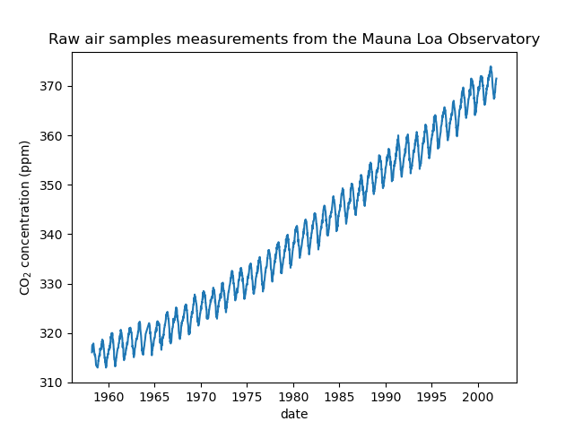
Modeling periodic data with periodic kernel
Simple dataset: Mauna Loa CO2 concentration measurements
Goal: Interpolate data correctly and use periodicity to extrapolate
Rasmussen, Carl Edward. “Gaussian processes in machine learning.” Summer school on machine learning. Springer, Berlin, Heidelberg, 2003.
Keeling, C. D., Bacastow, R. B., Bainbridge, A. E., Ekdahl Jr, C. A., Guenther, P. R., Waterman, L. S., & Chin, J. F. (1976). Atmospheric carbon dioxide variations at Mauna Loa observatory, Hawaii. Tellus, 28(6), 538-551.
Beck, E.-G. (2008). 50 Years of Continuous Measurement of CO2 on Mauna Loa. Energy & Environment,

Slide 14
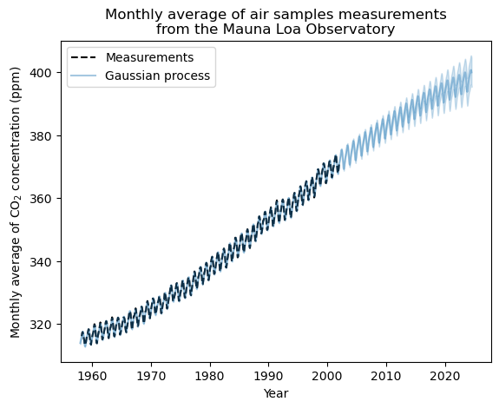
Modeling periodic data with periodic kernel
Prediction with complex kernel (from scikit-learn)
squared exponential + squared exponential * periodic kernel + rational quadratic + squared exponential +whitenoise
Good regression and extrapolation ✓
D. Duvenaud (2014). "The Kernel Cookbook: Advice on Covariance functions". https://www.cs.toronto.edu/~duvenaud/cookbook/
Scikit-learn: Machine Learning in Python, Pedregosa et al., JMLR 12, pp. 2825-2830, 2011

Slide 15
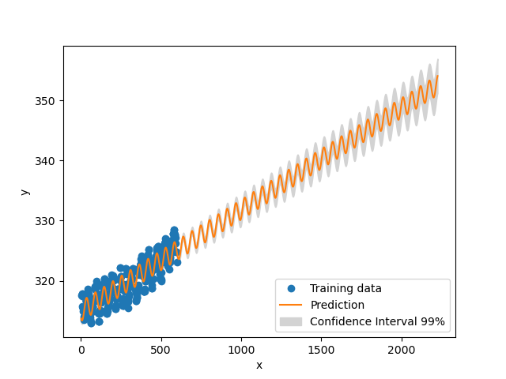
Modeling periodic data with periodic kernel
Prediction with periodic kernel
periodic kernel
« Good » extrapolation but poor interpolation

Slide 16
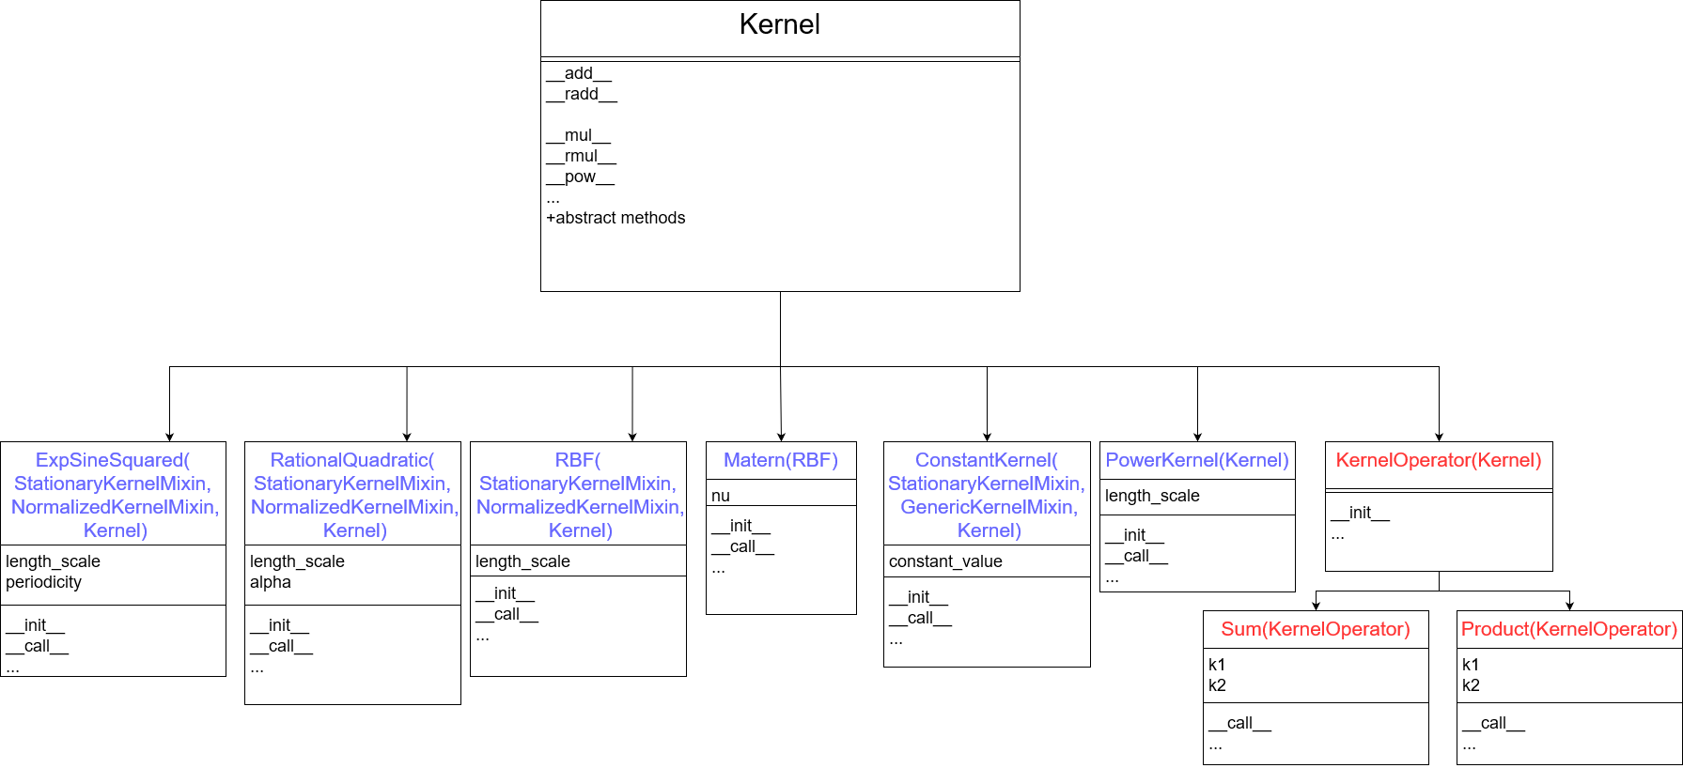
Modeling periodic data with periodic kernel
To solve this issue: New architecture for kernels in SMT
kernel1+kernel2
kernel1*kernel2

Slide 17
01
Motivation
Contents
02
03
04
05
Gaussian
Process
Frequency
Kernel
VALIDATION
Conclusions Perspectives

Slide 18
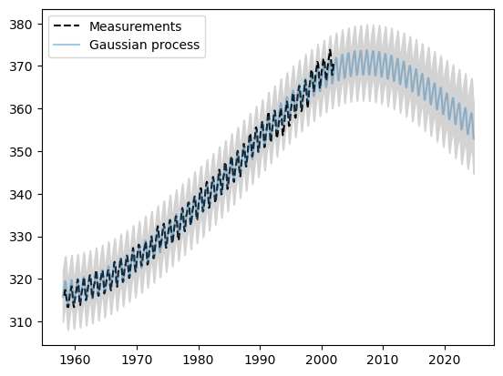
Validation (Mauna Loa observation)
Kernel = squared exponential*periodic kernel +squared exponential
poor extrapolation and interpolation

Slide 19
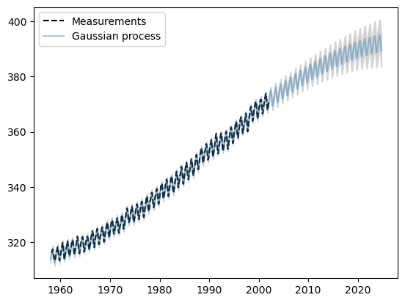
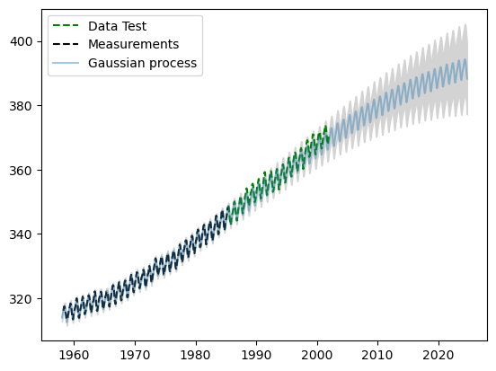
Validation (Mauna Loa observation)
Kernel = squared exponential*periodic kernel +squared exponential + rational quadratic
Similar results as scikit-learn with a simpler kernel.
Successful regression and good extrapolation.

Slide 20
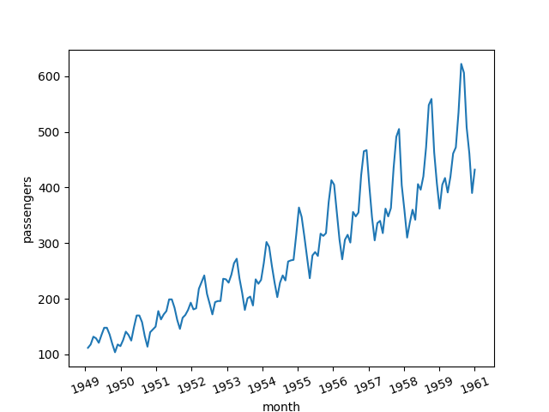
Validation (international airline passengers)
International airline passengers

Slide 21
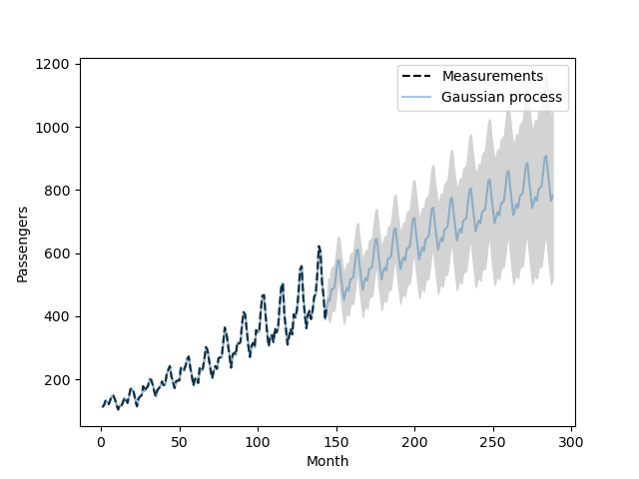
Validation (international airline passengers)
Kernel = squared exponential*periodic kernel +squared exponential + rational quadratic

Slide 22
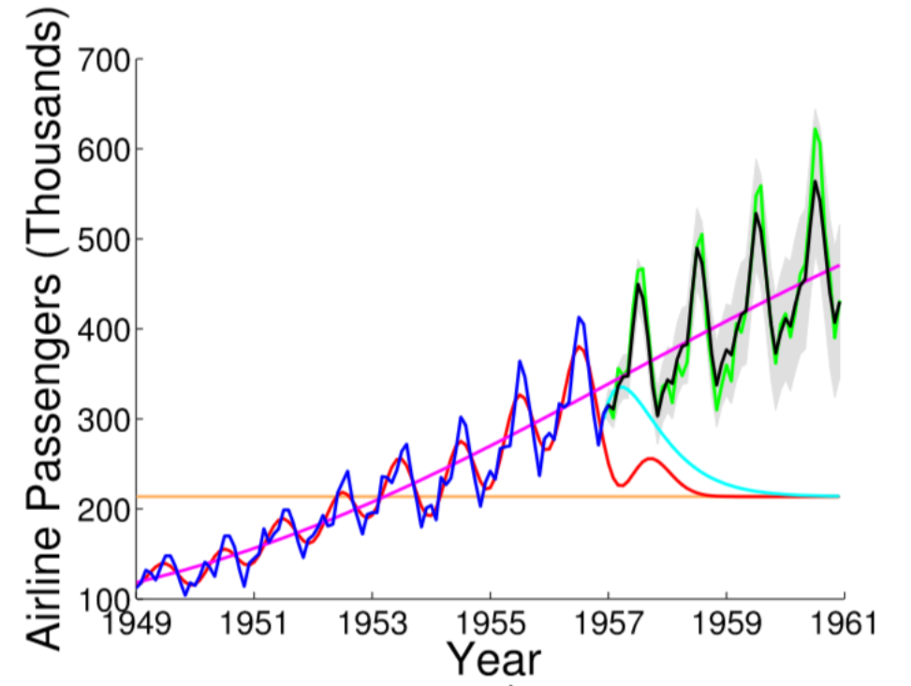
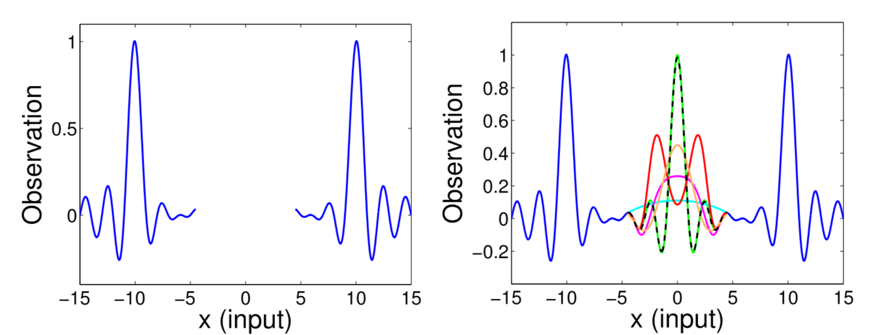
Validation (international airline passengers)
Better handling of variational amplitude
Comparison of spectral mixture (dashed) from (1) and real data (green), periodic (orange), squared exponential (red), matern (cyan), rational quadratic (magenta)
Training and testing data are in blue and green respectively. The prediction is shown in black and the confidence interval is in gray shade.
(1) A. Wilson and R. Adams. “Gaussian process kernels for pattern discovery and extrapolation”, International Conference on Machine Learning (2013)

Slide 23
01
Motivation
Contents
02
03
04
04
Gaussian
Process
Frequency
Kernel
VALIDATION
Conclusions Perspectives

Slide 24
Conclusions and Perspectives
Developed new kernel to increase extrapolation results but that still have interpolation issue.
To solve this issue: New architecture for kernels in SMT
Easier computation of new features
Allow user-defined kernels so we can create more complex kernel, better suited to a situation
Work in progress :
Adding more classical kernels and combination
Making the kernel combination available to the user
Perspectives :
Explore other kernels definition such as spectral mixture or combining kriging with a Fourier transform
Combine kernel combination with dimension reduction technique if possible
David Duvenaud (2014). "The Kernel Cookbook: Advice on Covariance functions". https://www.cs.toronto.edu/~duvenaud/cookbook/
Hensman, J., Durrande, N. and Solin, A. "Variational Fourier features for Gaussian processes." Journal of Machine Learning Research

Slide 25




Thank you for your attention!

Slide 26
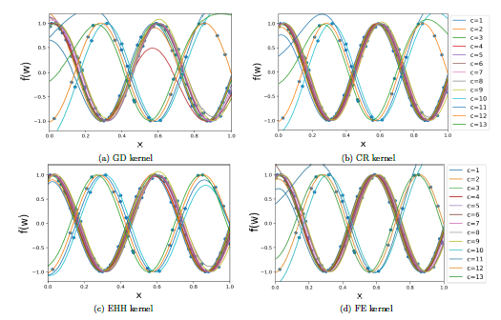
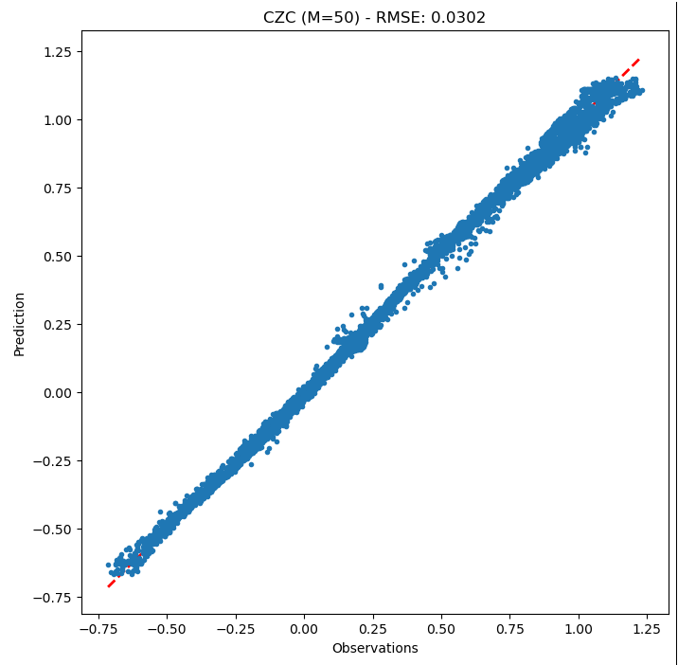
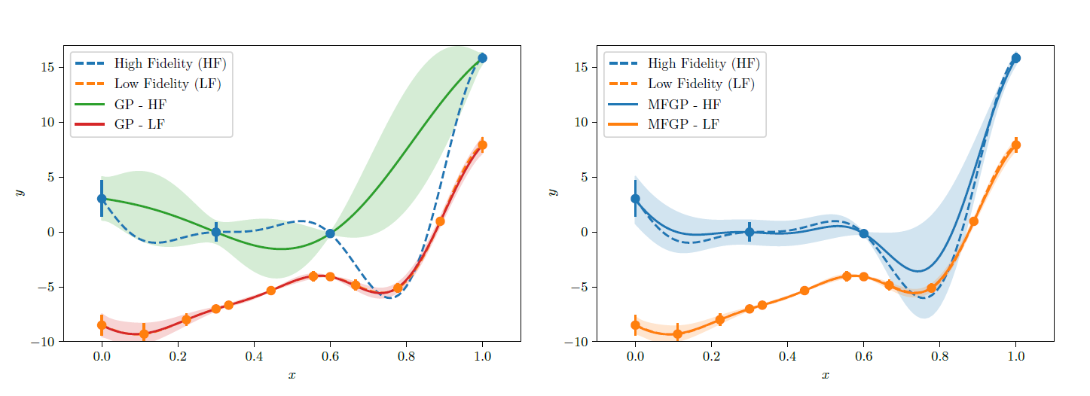
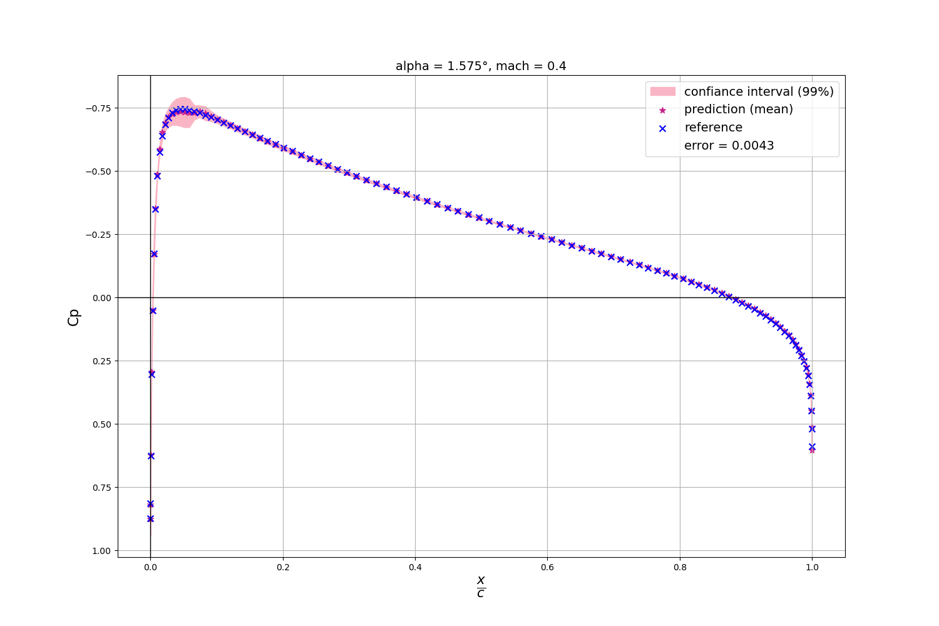
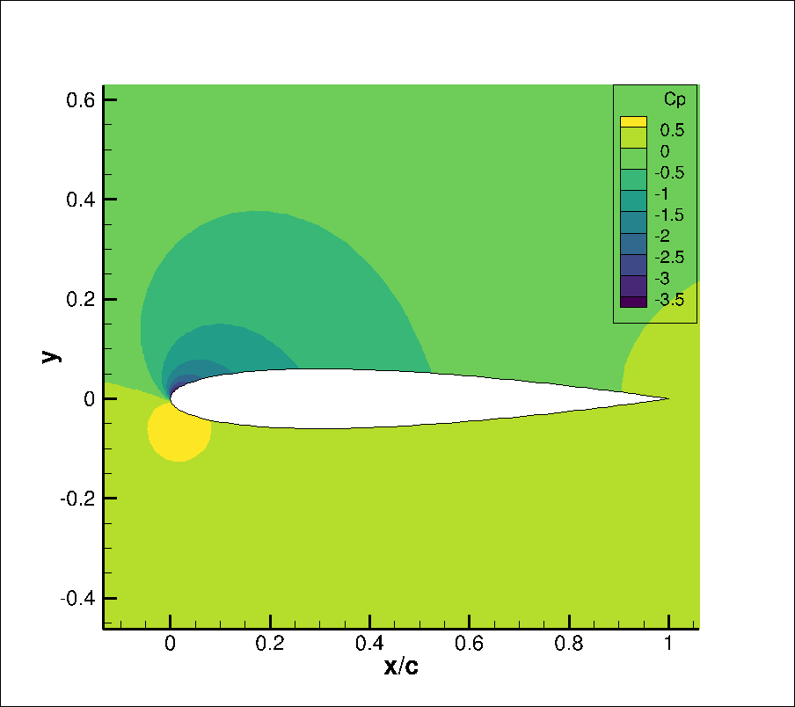

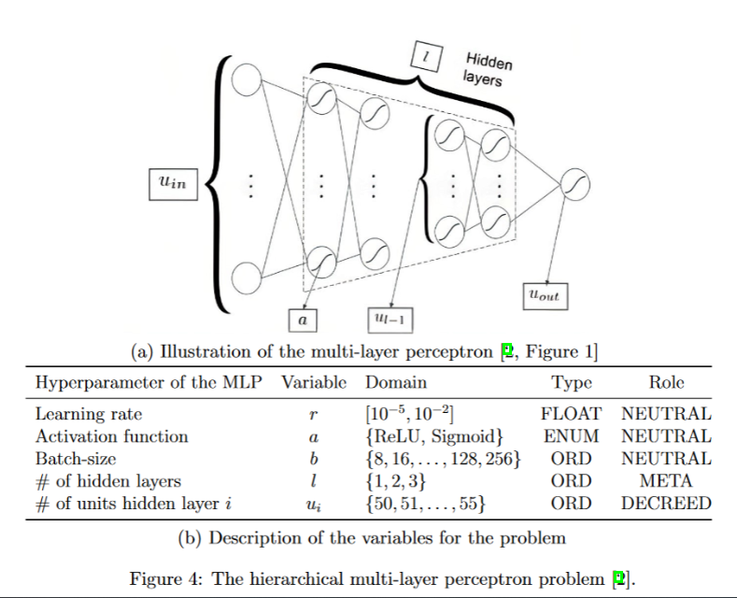

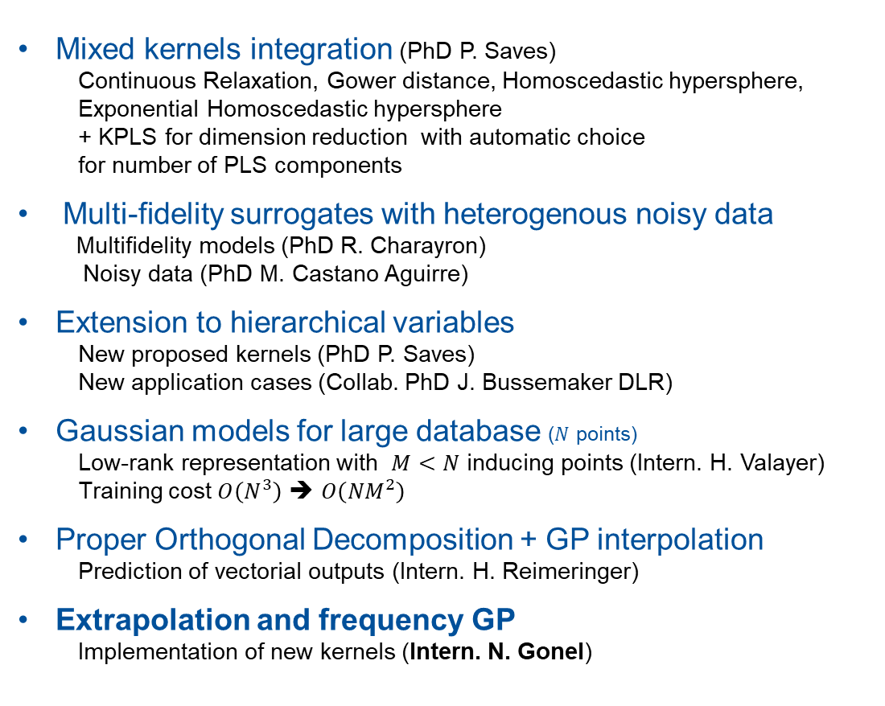
SMT recent activities
N=52227 observations in 4D
M=50 inducing points
Mixed kernels integration (PhD P. Saves)
Continuous Relaxation, Gower distance, Homoscedastic hypersphere,
Exponential Homoscedastic hypersphere
+ KPLS for dimension reduction with automatic choice
for number of PLS components
Multi-fidelity surrogates with heterogenous noisy data
Multifidelity models (PhD R. Charayron)
Noisy data (PhD M. Castano Aguirre)
Extension to hierarchical variables
New proposed kernels (PhD P. Saves)
New application cases (Collab. PhD J. Bussemaker DLR)
Gaussian models for large database ($N$ points)
Low-rank representation with $M<N$ inducing points (Intern. H. Valayer)
Training cost $O\left(N^{3}\right)$ ➔ $O\left({NM}^{2}\right)$
Proper Orthogonal Decomposition + GP interpolation
Prediction of vectorial outputs (Intern. H. Reimeringer)
Extrapolation and frequency GP
Implementation of new kernels (Intern. N. Gonel)
P. Saves, R. Lafage, N. Bartoli, Y. Diouane, J. Bussemaker, T. Lefebvre, J. Hwang, J. Morlier, J. Martins, SMT 2.0: A Surrogate Modeling Toolbox with a focus on Hierarchical and Mixed Variables Gaussian Processes, 2024, Advances in Engineering Software.
H. Valayer, N. Bartoli, M. Castaño-Aguirre, R. Lafage, T. Lefebvre, A. F. López-Lopera, S.Mouton, A Python Toolbox for Data-Driven Aerodynamic Modeling Using Sparse Gaussian Processes. 2024, Aerospace.

Slide 27
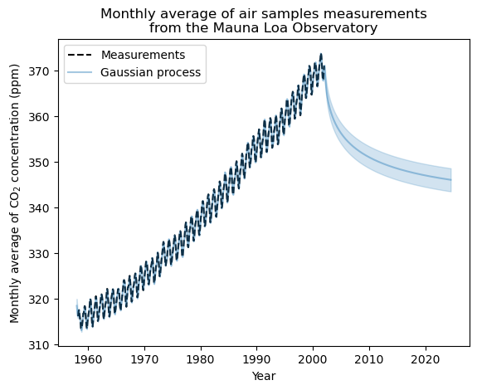
Modeling periodic data with periodic kernel
Prediction with classical kernel
rational quadratic
Good regression but poor extrapolation

Slide 28
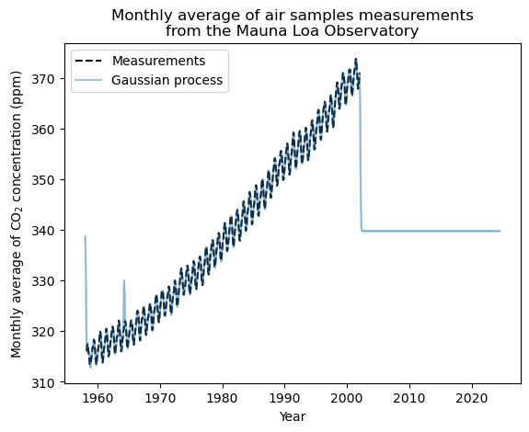
Modeling periodic data with periodic kernel
Prediction with classical kernel
squared exponential
Poor regression and extrapolation

